Slide 1
Choosing Computer Science for A-level and as a Career
By Prith (STEM Ambassador)

Slide 2
About me:
Studied Computer Science GCSE
Studied Computer science at Alevel
Currently studying Computer Science at the University of Glasgow just finished first year

Slide 3
Contents
Why Alevel CS
What to expect in Alevel CS
Why career in CS (Software engineer)
Typical Timeline for career in CS
Degree apprenticeship (after Alevels)
Interviews (degree app and internships)
Researcher career in CS
More advice and opportunities to help Uni applications and career in CS
About the worksheet
Questions

Slide 4
Why choose Alevel CS
Enjoy problem solving and logical thinking
helps a lot in University and Career in CS
Learn programming as a convenience to automate daily tasks
Scientific skill e.g. visualising data
Platform to express your creativity e.g. game, unique application, hardware
If your idea is creative and unique it can be a source of income

Slide 5
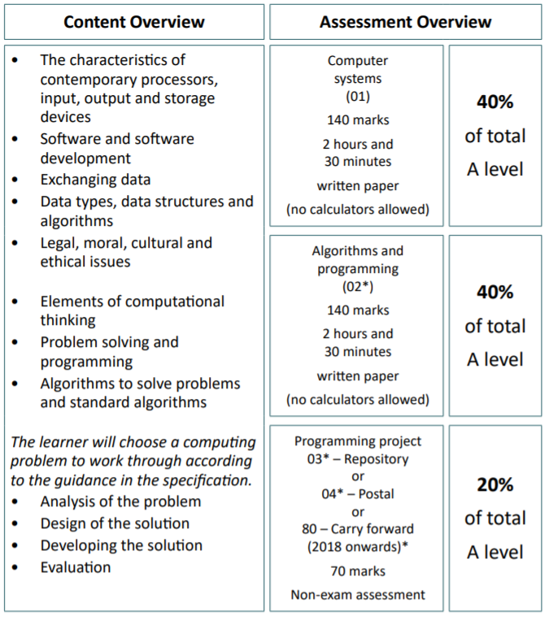
What to expect - Alevel CS (theory)
The main topics that are different to CS at GCSE:
Software development: memory management, stages of compilation, programming methodologies, object oriented programming
Data Structures: linked-list, stack, queue, binary search tree
Elements of computational thinking: abstraction, preconditions, identifying sub procedures, determine part of problem tackled at the same time.
Problem solving and programming: Recursion, debugging, Computation methods: backtracking and data mining.
Algorithms: Big O notation, time and space complexity, Dijkstra’s algorithm and A* algorithm

Slide 6

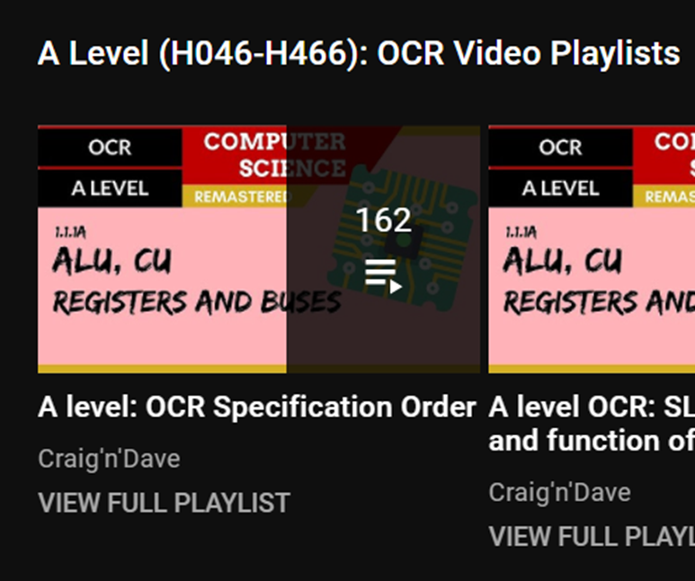
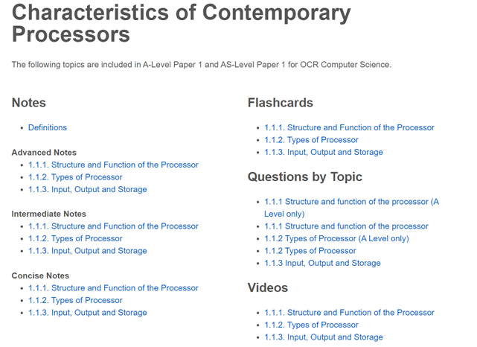
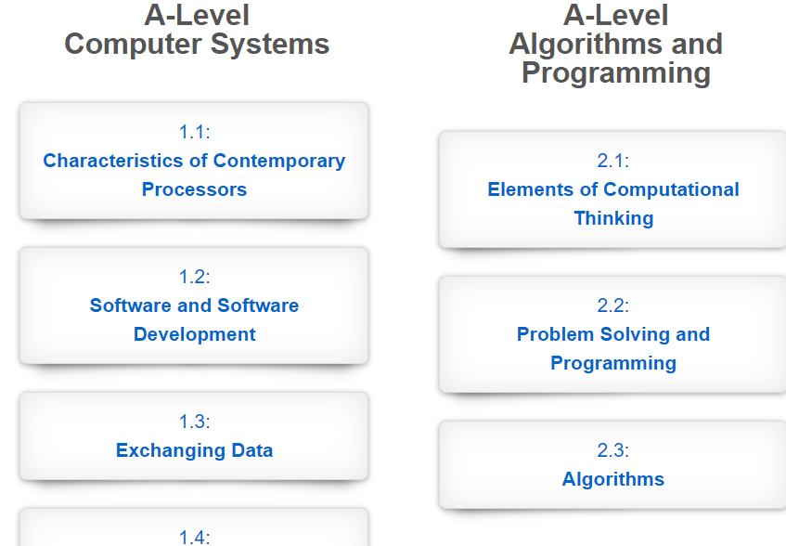
Resources to help with A level theory
Other than classroom lessons, textbook, and past papers

Slide 7
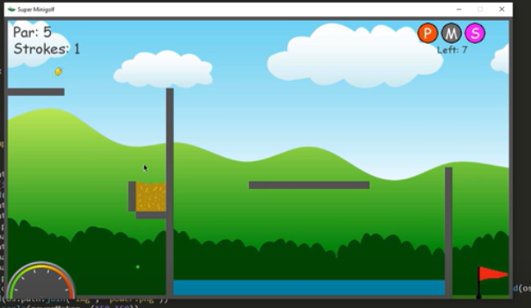
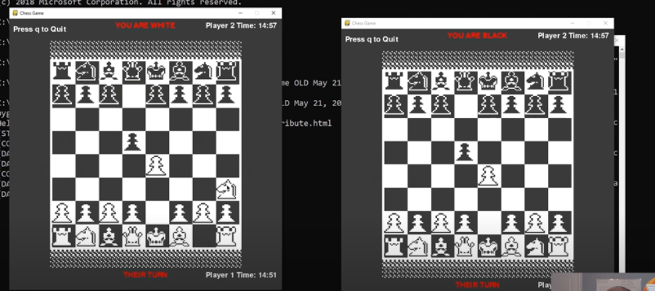

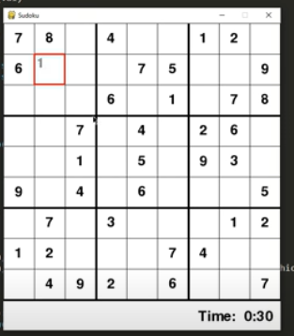
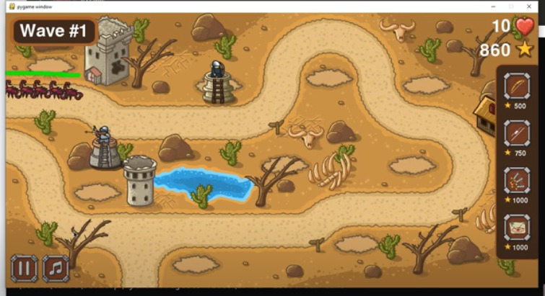
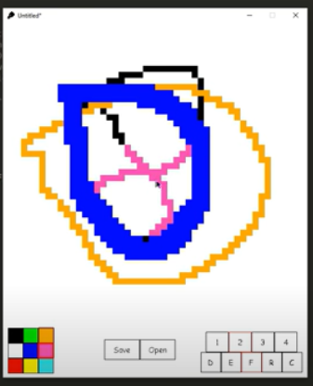
What to expect - Alevel CS (programming)
(4 parts) analysis, design, development, evaluation:
Analysis
Create an application to solve a problem
E.g. for a game: making people more interested in gaming, reduce boredom in Alevel students
Pick stakeholders
Friends, someone knowledgeable about what your creating
Research the problem:
e.g. analyse other games that do this, and take features from theirs that helps solve your problem
Have requirements
E.g. for the game, make it 2 player, platformer, highscores
Design
Break down your problem to smaller parts
Describe initial idea of the structure of the solution
Explain the test data to handle errors
Developing the solution
Agile Iterative development
Testing between iterations
Evaluation
Testing the end solution
Success of the solution
maintainance
Ideas: game, booking system
Tech with Tim many tutorial projects (basic – advanced)
If the only language you know is python and interested in game dev, try using pygame
Pictures of projects made by Tech with Tim
Notes:
End of this slide show the RPG game I made using pygame

Slide 8
Benefits of CS as a career
Enjoy problem solving
Wide field: Software engineer, data analyst, cyber security, game dev
Keep learning as field keeps changing
Many job opportunities (and keeps increasing)
Well paid
Creative outlet - source of income

Slide 9


Typical Timeline to get a career in CS
Optional but Recommended: CS at GCSE
Create a unique application that benefits many users
Alevel
Compulsory: Maths at Alevel
If Applied and Successful in degree apprenticeship(s) interview?
Optional but Very Recommended: Computer Science at Alevel
Compulsory for few Uni: Further Maths at Alevel
Degree apprenticeship
If meet Uni entry requirements?
If Applied and were Successful in internship(s) interview
Optional but Very Recommended: Computer Science at University
Internship
If Successful in grad job(s) interview
Grad job

Slide 10









Degree apprenticeships
What are degree apprenticeships
Achieved a full degree at a university, whilst working and getting paid at a company, building you up so that you get a full-time role by the end of it.
Apply in summer year 12 or early year 13
Disadvantages:
The degree you get is typically ‘digital and technological solutions’ and you might not learn certain topics if you were at university e.g. AI …
Cannot do Masters or pHD, restricting certain career paths e.g. researcher
Holidays are the same as if you were working a full-time
Not the same uni experience
Advantages:
Less competition to land a job at top companies than uni grads – less people applying and easier interviews
No student loan of 27k
Get paid salary usually 19k to 23k and keeps increasing
Job at the company after degree apprenticeship finished
Some degree apprenticeships partner with top UK unis
Best chance of being successful
Getting good predicted grades at the end of year 12 or start of year 13 helps when people get selected for the interview
Understand the interview process and stand out
Etc.

Slide 11
Interview process for degree apprenticeships and internships if you go Uni
Behavioural interview questions
Tell me about a situation where you overcome an obstacle/ demonstrated teamwork/ leadership/ worked with a difficult colleague
STAR: Situation, Task, Action, Result
Situation: DofE, NCS, sports team, work experience, giving a performance etc.
Group interview questions
Given information about e.g. 5 different video games and with varying reviews, no. of buys, awards, features of the game etc. In your group discuss which is the best video games and after the time limit explain why it to the assessor.
Or
Everyone in earth will die, apart from 5 candidates and you have to choose from the list: a male accountant and his wife, a doctor, a phycologist, an NBA basketball player, the current UK Prime Minister, a person who knows how to wield a katana (sword), a female singer, a priest, and a Olympic swimmer.
With these questions there no right or wrong answer, they're assessing how well you work as a group: Teamworking, logical thinking, creative ideas and communication
Tips: Strategise the best way to assess each option, listen, be inclusive and respectful for group members opinions, keep a track of the time, help push the discussion forward conversion forward when necessary.

Slide 12
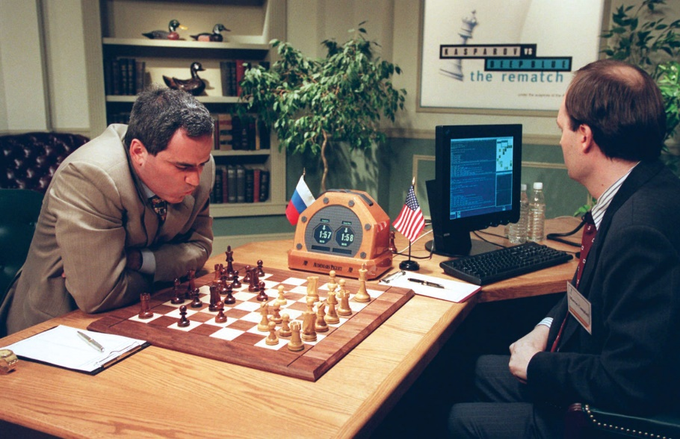
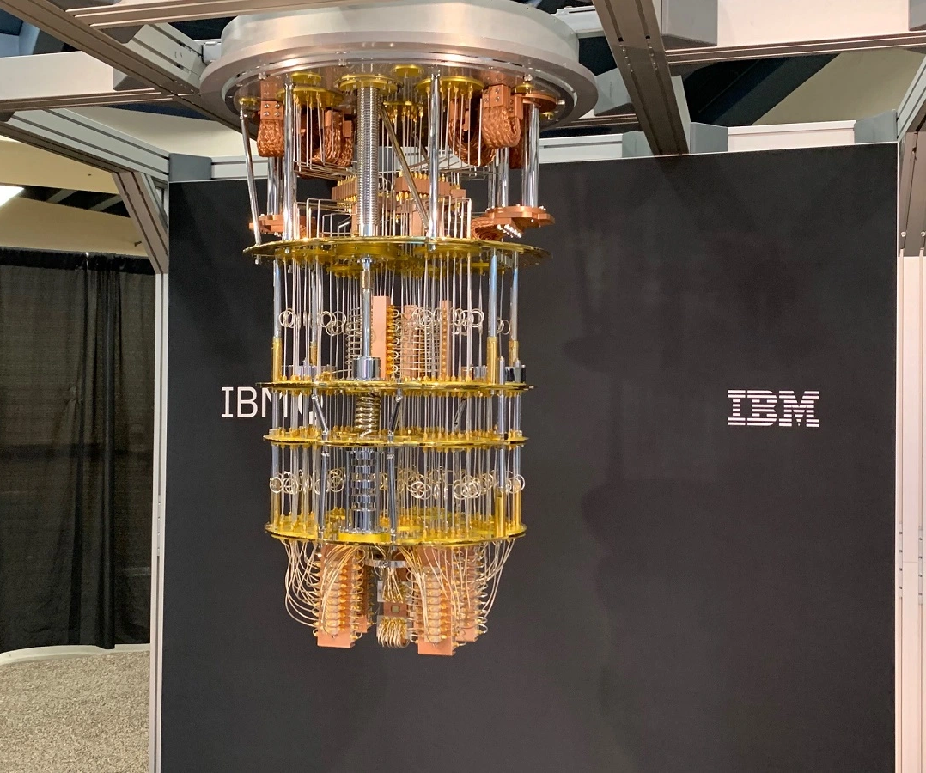

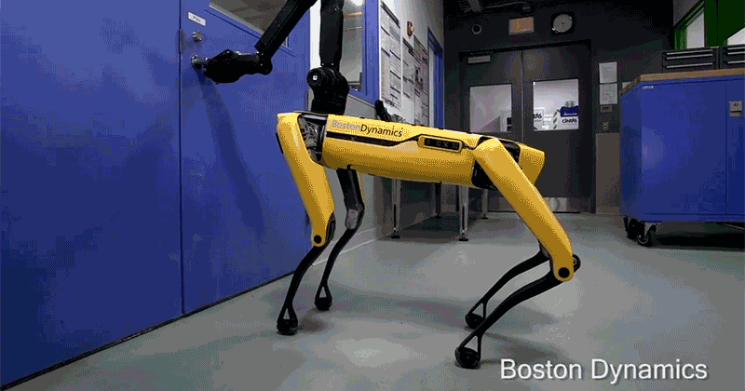

Researcher
University - pHD
Progress:
Deep blue beat world chess champion
Quantum computing
Boston dynamics: Spot the dog
Elon Musk: Open AI and Neural Link
Future:
Artificial General intelligence
Neuralink: help people with neurological disorders
May 11, 1997, IBM ® Deep Blue ®
Adam Nadel/AP Images
The IBM Q quantum system at Semicon West.
Image Credit: Dean Takahashi

Slide 13
Personal statement to study CS at university
Opportunities for year 12
Imperial college London taster days ‘The Future of computing’ or ‘How maths drives computing’
Cambridge Masterclass Computer Science
Summer school Oxford
Independent things
Programming Projects
Reading a book (reading list of the university)
Volunteering (code clubs)
Extra curriculars (music, sport, etc)

Slide 14
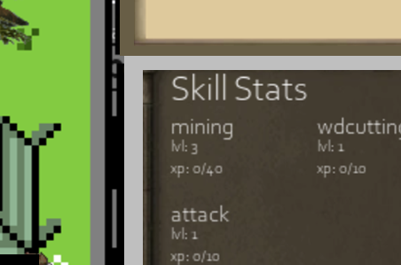
Why worksheet
Data structure and algorithm questions
Alevels
Essential for problem solving in programming
When you are creating an application e.g. in my game
(loading lvls from total experience question in my worksheet)
If you go university, technical interviews for internships have data structures and algorithm questions
If you want to get into competitive programming (google code jams)

Slide 15
Questions?

